Slide 1
Chapter 10 Thinking in Objects

Slide 2
Objectives
To apply class abstraction to develop software (§10.2).
To explore the differences between the procedural paradigm and object-oriented paradigm (§10.3).
To discover the relationships between classes (§10.4).
To design programs using the object-oriented paradigm (§10.5–10.6).
To create objects for primitive values using the wrapper classes (Byte, Short, Integer, Long, Float, Double, Character, and Boolean) (§10.7).
To simplify programming using automatic conversion between primitive types and wrapper class types (§10.8).

Slide 3
Introduction
The preceding chapter introduced objects and classes. You learned how to define classes, create objects, and use objects of several classes in the Java API (e.g., Date, and Random).
The focus of this chapter is on class design and explores the differences between procedural programming and object-oriented programming.
This chapter will demonstrate how to solve problems using the object-oriented paradigm.

Slide 4
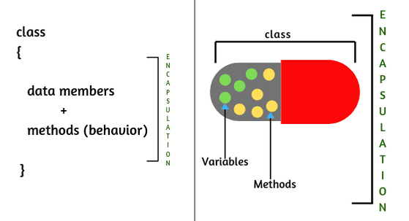
Class Encapsulation
Class Encapsulation means hiding the details of the implementation from the user.

Slide 5
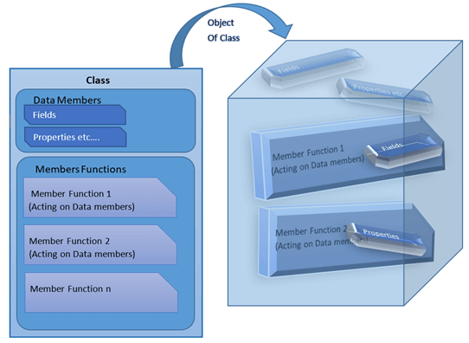
Class Abstraction
Class Abstraction means separating the class implementation from the use of the class.

Slide 6

Class Abstraction and Encapsulation
The creator of the class provides a description of the class and lets the user know how the class can be used.
The user of the class does not need to know how the class is implemented.
The collection of methods and fields that are accessible from outside the class, together with the description of how these members are expected to behave, serves as the Class’s Contract.
The details of the implementation is encapsulated and hidden from the user.

Slide 7
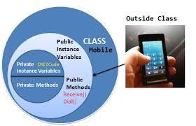
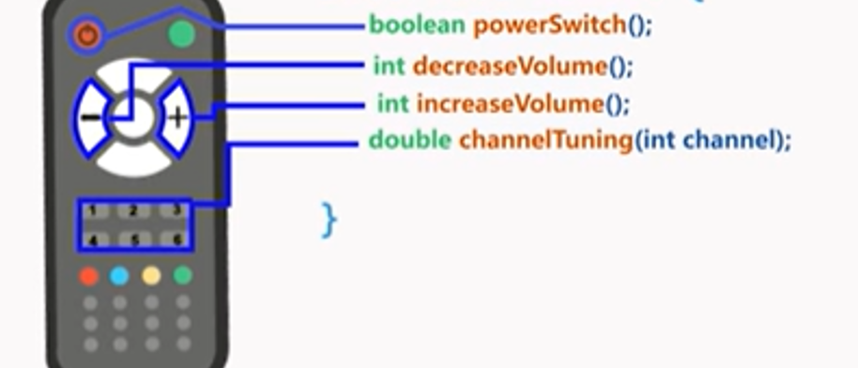
Example

Slide 8
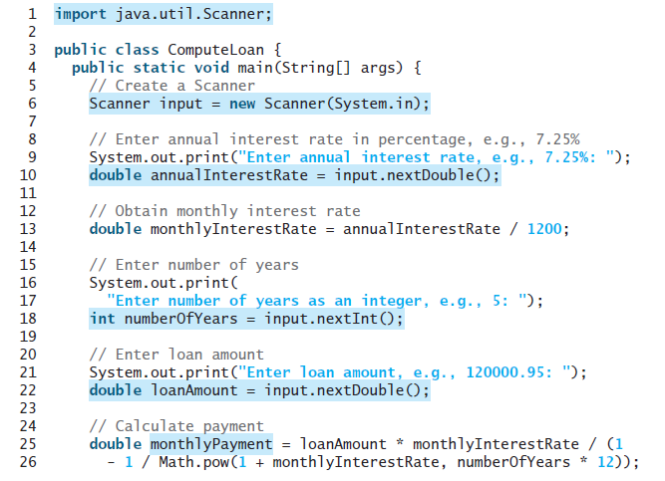
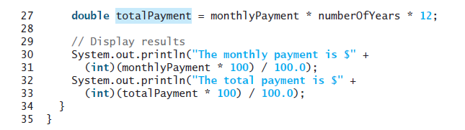
This program cannot be reused in other programs because the code for computing the payments is
in the main method.
The traditional procedural programming paradigm is action-driven, and data are separated from actions.

Slide 9
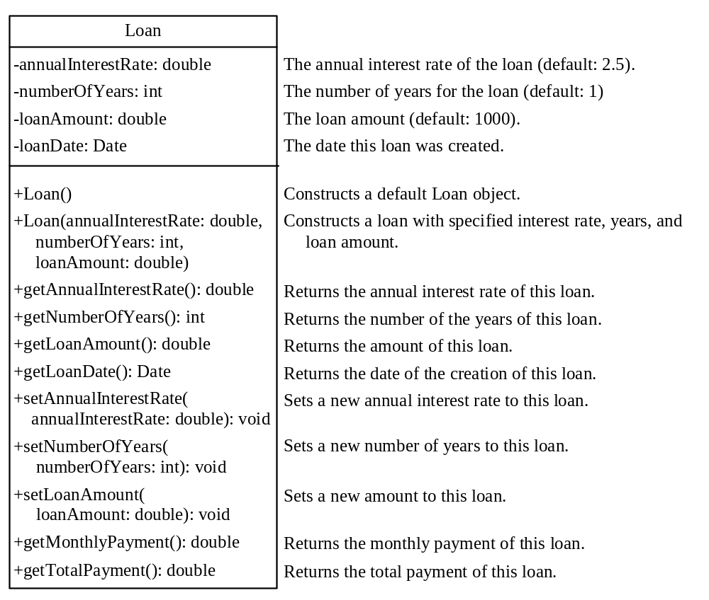
Designing the Loan Class
The object-oriented programming paradigm focuses on objects, and
actions are defined along with the data in objects.
serves as the contract for the Loan class
Loan
TestLoanClass
Run

Slide 10
Class Abstraction and Encapsulation
The getter and Setter or other methods are the class contract. Signatures of public methods.
Clients use the class through the contract of the class.

Slide 11

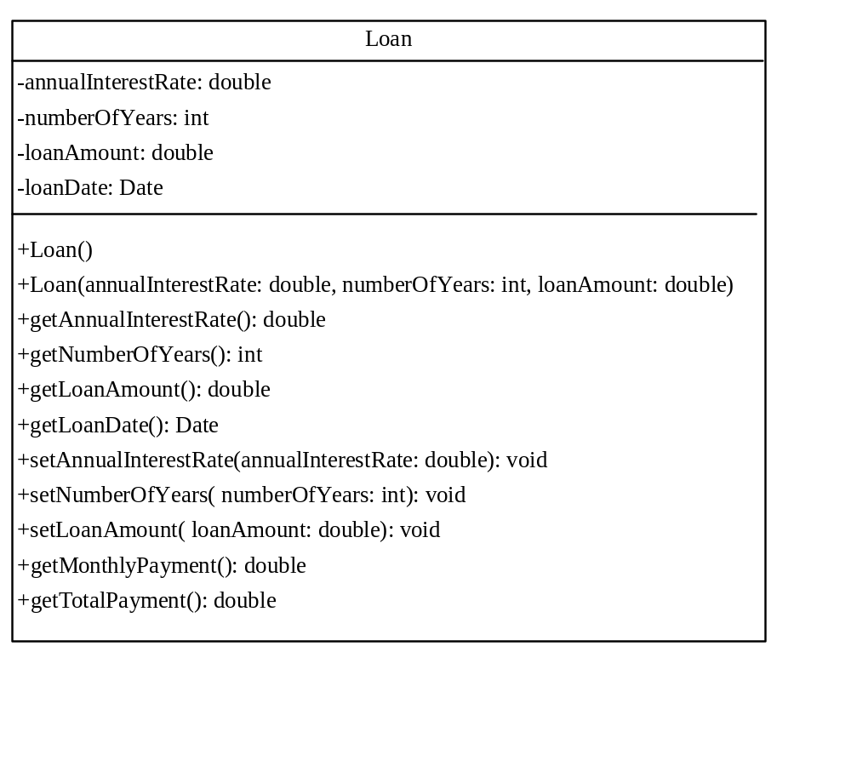
Designing the Loan Class
Create 6 Groups, Each group will perform a task
Loan
TestLoanClass
Run

Slide 12
The tasks
Declare the attributes
Declare the constructors
Define the getter and setter methods
Define the service methods
  Method to calculate the monthly payment
  Method to calculate the Total payment
Define the application class : Input the data ( yearly interest, number of years for the loan, loan amount )
Define the application class:
  Create A Loan Object
  Display loan Date , Monthly payment, Total Payment.

Slide 13
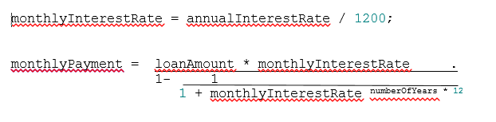
Service Methods
Method to calculate the monthly payment
Method to calculate the Total payment
getMonthlyPayment * numberOfYears * 12;

Slide 14


The attributes

Slide 15
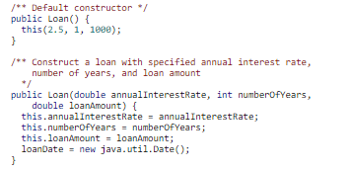
The constructors

Slide 16
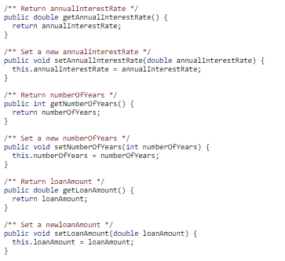

The getters and the setters

Slide 17
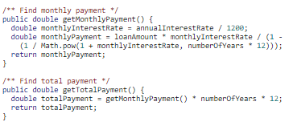
Service Methods
Method to calculate the monthly payment
Method to calculate the Total payment

Slide 18
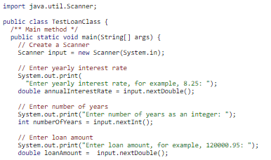
The Application class
Input the data (yearly interest, number of years for the loan, loan amount)

Slide 19
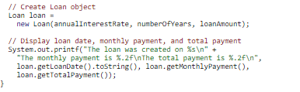
The Application class
Create A Loan Object
Display loan Date, Monthly payment, and Total Payment.

Slide 20
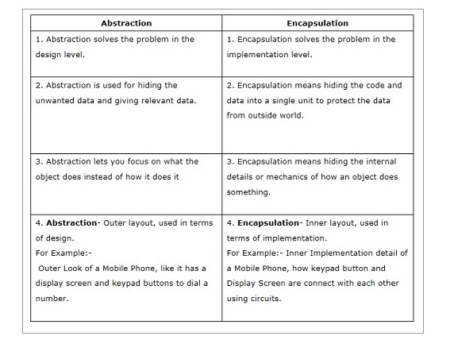

Slide 21
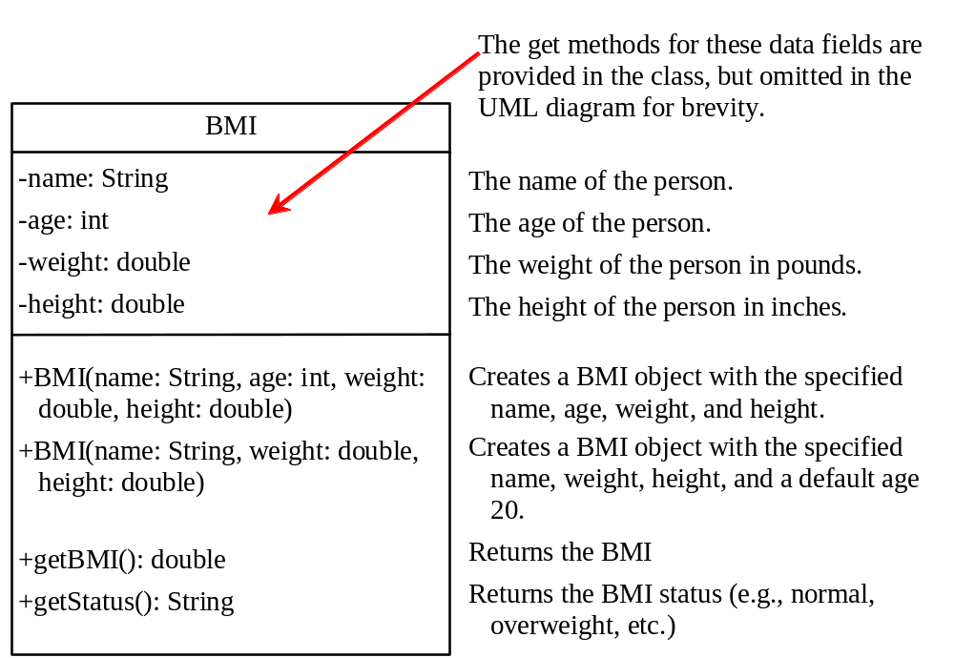
The BMI Class
Practice it @ home
BMI
UseBMIClass
Run

Slide 22
Object-Oriented Thinking
Previous Chapters introduced fundamental programming techniques for problem solving using loops, methods, and arrays.
The studies of these techniques lay a solid foundation for object-oriented programming.
Classes provide more flexibility and modularity for building reusable software.
This section improves the solution for a problem introduced in previous chapters using the object-oriented approach.
From the improvements, you will gain the insight on the differences between the procedural programming and object-oriented programming and see the benefits of developing reusable code using objects and classes.

Slide 23
Class Relationships
Classes in a software system can have various types of relationships to each other.
Three of the most common relationships:
  Dependency: A uses B
  Aggregation: A has-a B
  Inheritance: A is-a B
6-<number>

Slide 24
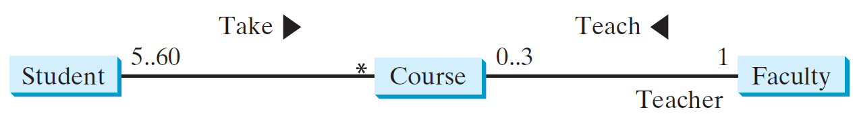
Association
Association is a general binary relationship that describes an activity between two classes.
For example:
  A student taking a course is an association between the Student class and the Course class.
  A faculty member teaching a course is an association between the Faculty class and the Course class.
Relationship
multiplicity
direction of the relationship
Role

Slide 25
Multiplicity
The character * means an unlimited number of objects.
The interval m..n indicates that the number of objects is between m and n, inclusively.
each course
must have at least five and at most sixty students
faculty member may teach from zero to three courses per semester
Each course is taught by only one faculty
member
each student may take any number of courses

Slide 26
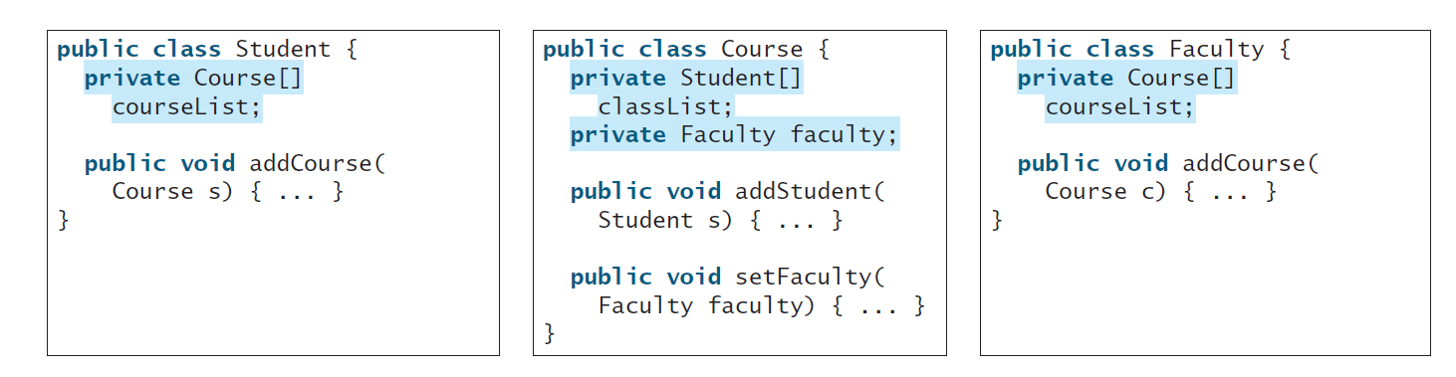
Implementing the Association Relations
We can implement associations using data fields and methods.
The relation “a student takes a course” is implemented using the addCourse method in the Student class and the addStudent method in the Course class.
The relation “a faculty teaches a course” is implemented using the addCourse method in the Faculty class and the setFaculty method in the Course class.

Slide 27
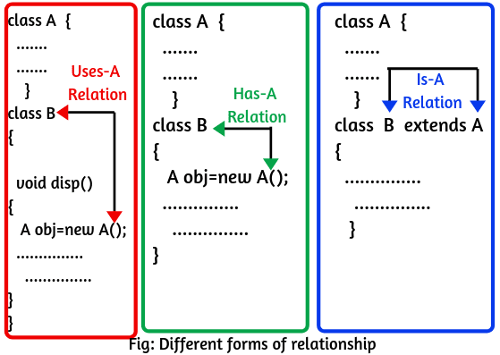
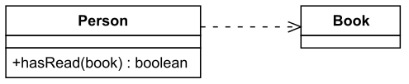
Dependency
A dependency exists when one class relies on another in some way, usually by invoking the methods of the other.
We've seen dependencies in many previous examples.
Symbolized by an arrow pointing from the dependent class to the independent class.
© 2004 Pearson Addison-Wesley. All rights reserved
6-<number>

Slide 28
Dependency
Find it
6-<number>

Slide 29
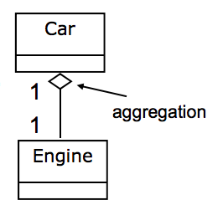
Aggregation
Aggregation is a special form of association that represents an ownership relationship between two objects.
Aggregation is a has-a or part-of relationship.
  A car has an engine
An aggregating object contains references to other objects as instance data.
The subject object is called the aggregated object.
The owner object is called an aggregating object.
Symbolized by a clear white diamond.
© 2004 Pearson Addison-Wesley. All rights reserved
6-<number>

Slide 30
Aggregation
Find it
public class Student {
private int id;
private BirthDate birthDate;
public Student(int ssn,
int year, int month, int day) {
id = ssn;
birthDate = new BirthDate(year, month, day);
}
public int getId() {
return id;
}
public BirthDate getBirthDate() {
return birthDate;
}
}
6-<number>

Slide 31
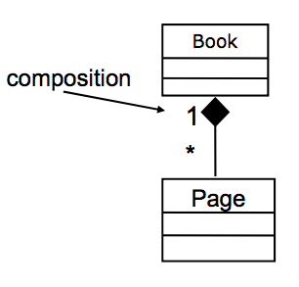
Composition
If an object is exclusively owned by an aggregating object, this relation is called composition.
Composition is a stronger version of aggregation.
  – the parts live and die with the whole.
  – symbolized by a black diamond.
Examples:
  A student has a name
  A book has pages
  A building has concrete blocks
6-<number>

Slide 32
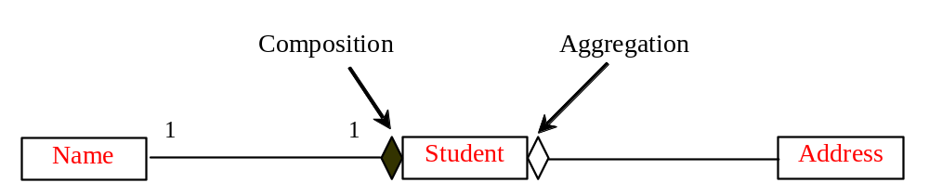
Aggregation and Composition
“A student has a Name”, If an object is exclusively owned by an aggregating object, What is it called?
  “A student has an Address”, an address could be shared by more than one student, What is it called?

Slide 33
Aggregation and Composition
Composition
Aggregation
“A student has a Name”, If an object is exclusively owned by an aggregating object, Composition.
  But “A student has an Address”, an address could be shared by more than one student, Aggregation.

Slide 34
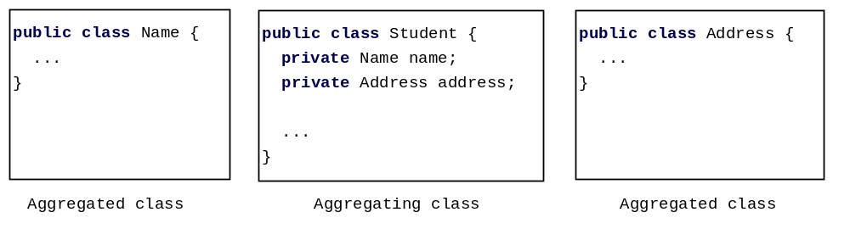
Implementation of Aggregation and Composition Relations
An aggregation relationship is usually represented as a data field in the aggregating class.
The relation “a student has a name” and “a student has an address” are implemented in the data field name and address in the Student class.

Slide 35
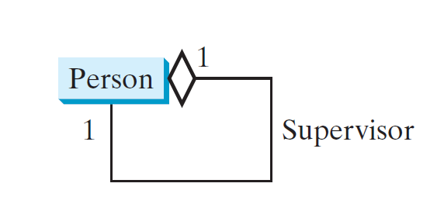
Aggregation Between Same Class
Aggregation may exist between objects of the same class. For example, a person may have a supervisor.
public class Person {
// The type for the data is the class itself
private Person supervisor;
...
}

Slide 36
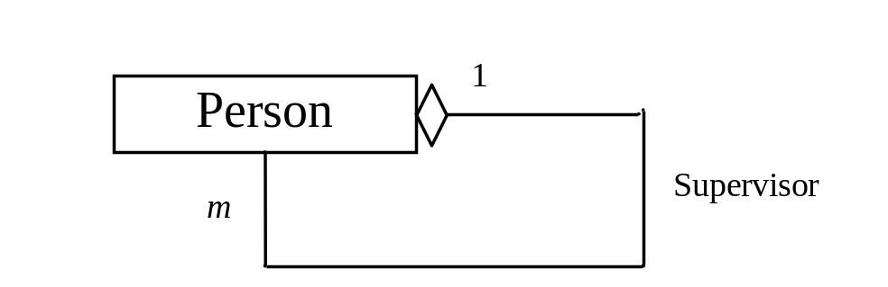
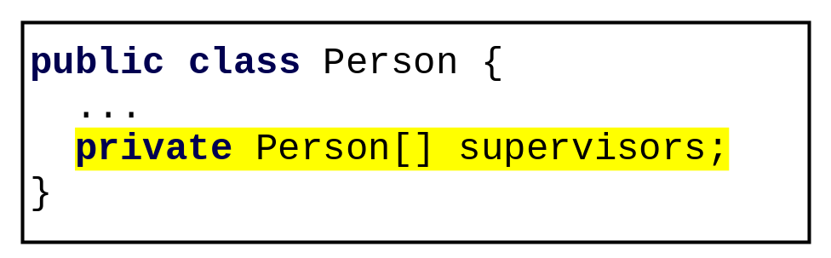
Aggregation Between Same Class
What happens if a person has several supervisors?

Slide 37
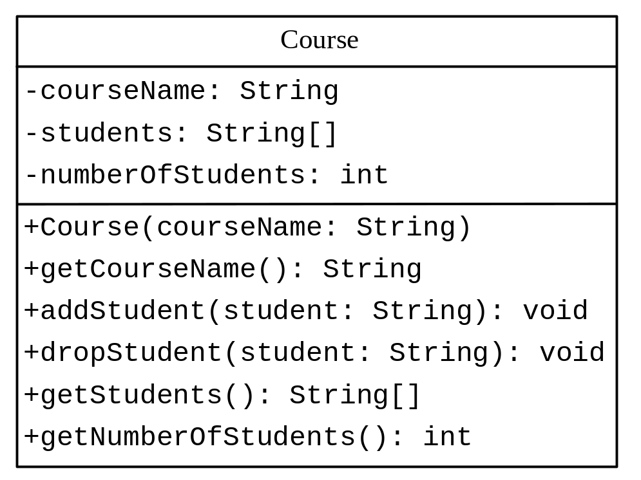
Example: The Course Class
Course
TestCourse
Run

Slide 38
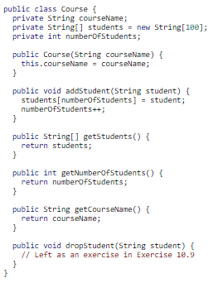
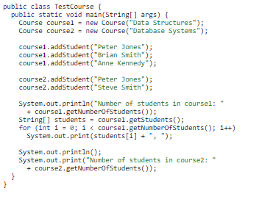

Slide 39

Should a Student be represented as a String type only?
How can you modify the code?
Write the implementation of the dropStudent method.

Slide 40
public void dropStudent(String student) {
for(int i=0; i<numberOfStudents; i++) { if(students[i].equals(student)) {
    for (int k = i+1 ; k< numberOfStudents; k++){
    students[k–1] = students[k];
}
    numberOfStudents--;
    break ;
}
}
}

Slide 41

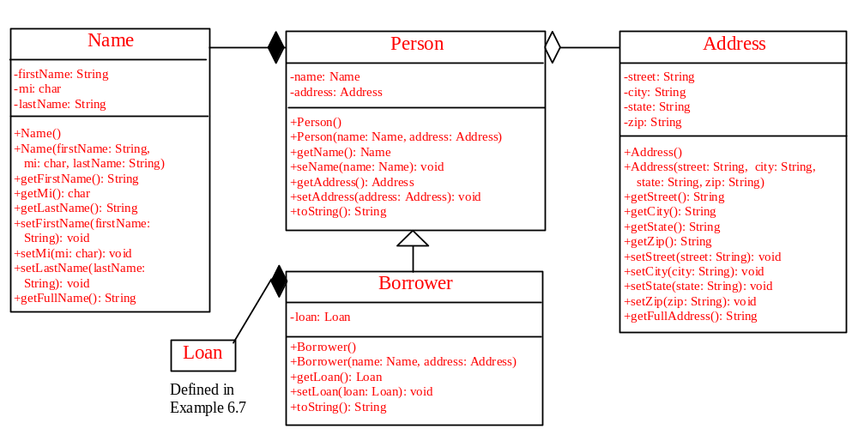
Test Your Knowledge
Draw the class relationships in the following UML diagram

Slide 42
Test Your Knowledge
Draw the class relationships in the following UML diagram

Slide 43
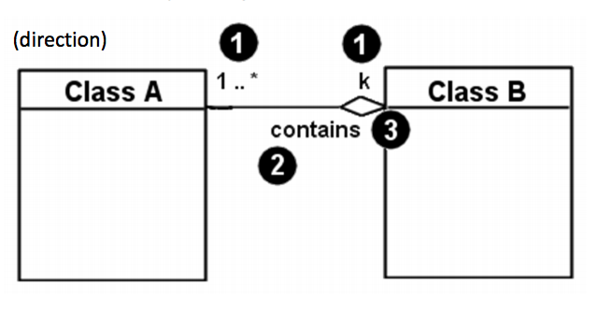
Revision of Class Relationships
Associational (usage) relationships
  Multiplicity (how many are used)
  * ⇒ 0, 1, or more
  1 ⇒ 1 exactly
  2..4 ⇒ between 2 and 4, inclusive
  3..* ⇒ 3 or more (also written as “3..”)
  name (what relationship the objects have)
  navigability (direction)

Slide 44
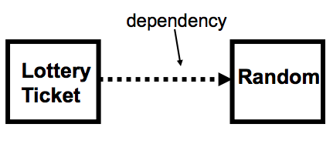
Revision of Classes Relationships
Aggregation: “is part of”
  – symbolized by a clear white diamond
Composition: “is entirely made of”
  – stronger version of aggregation
  – the parts live and die with the whole
  – symbolized by a black diamond
Dependency: “uses temporarily”
  – symbolized by dotted line
  – often is an implementation detail, not an intrinsic part of that object's state

Slide 45
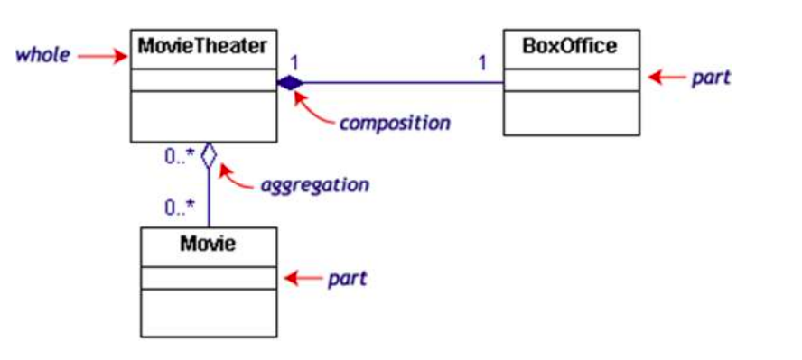
Draw the class relationships in the following UML diagram
Notes:
If the movie theater goes away so does the box office => composition
but movies may still exist => aggregation

Slide 46
Draw the class relationships in the following UML diagram
Notes:
If the movie theater goes away so does the box office => composition
but movies may still exist => aggregation

Slide 47
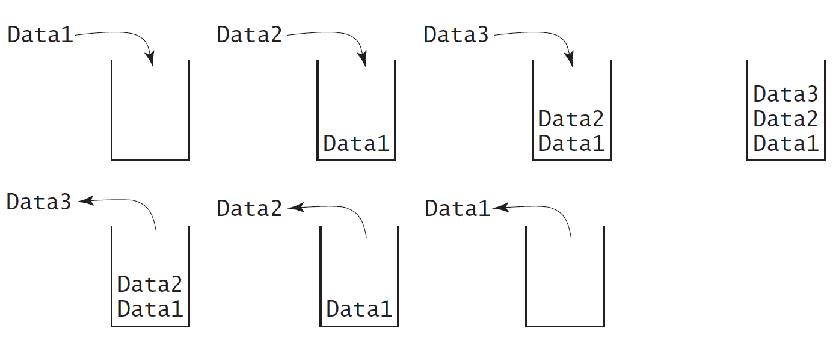
Designing the StackOfIntegers Class
a stack is a data structure that holds data in a last-in, first-out fashion

Slide 48

Example: The StackOfIntegers Class
void
TestStackOfIntegers
Run

Slide 49
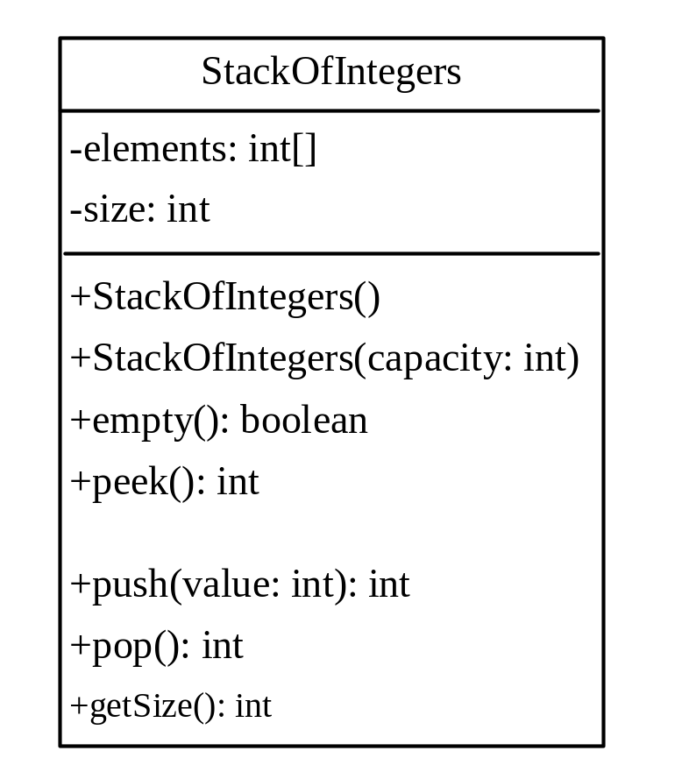

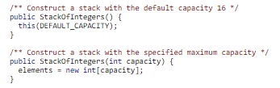
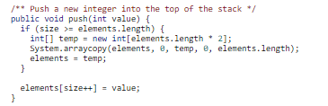




Example: The StackOfIntegers Class
void
TestStackOfIntegers
Run

Slide 50
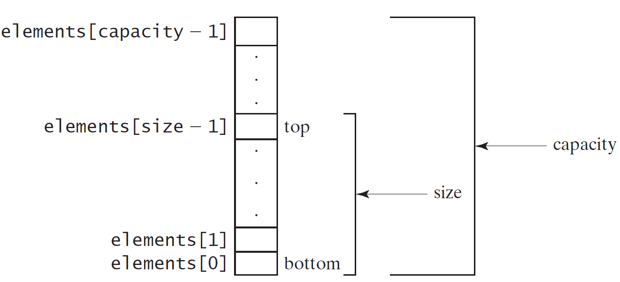
Implementing StackOfIntegers Class
StackOfIntegers

Slide 51
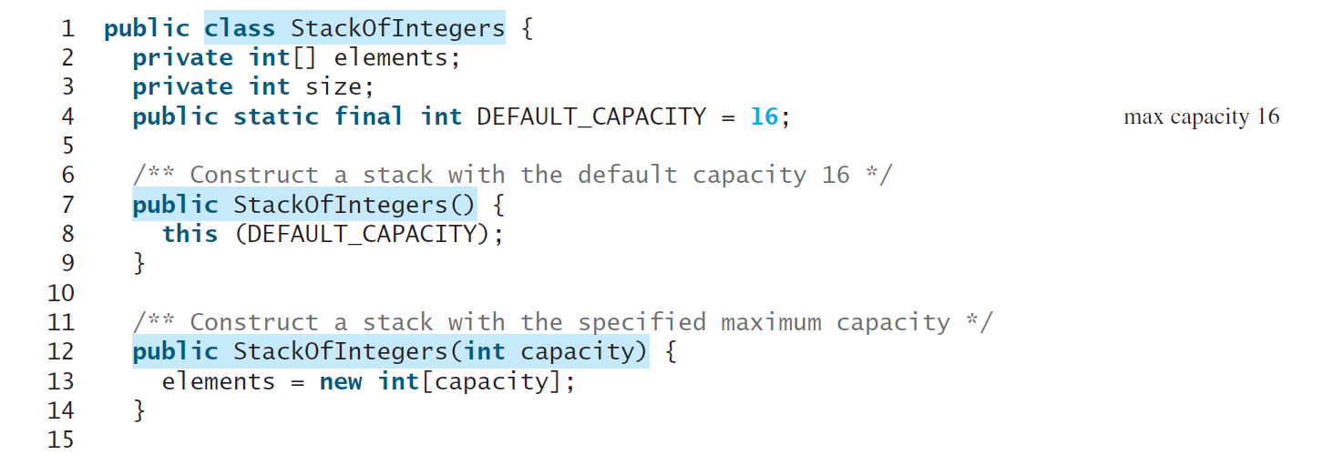
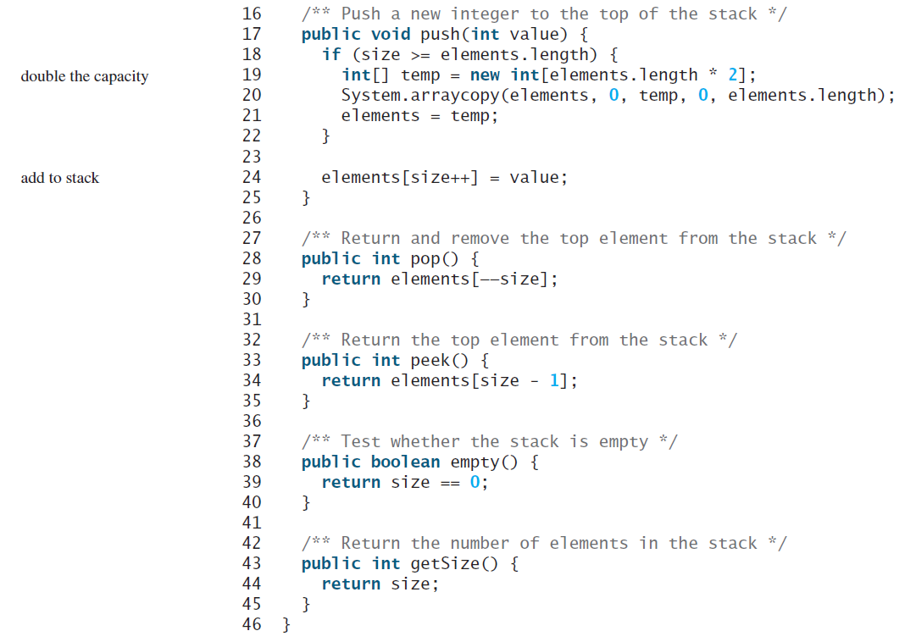

Slide 52
What is the output?
public class TestStackOfIntegers {
public static void main(String[] args) {
StackOfIntegers stack = new StackOfIntegers();
for (int i = 0; i < 10; i++)
stack.push(i);
while (!stack.empty()) {
System.out.print(stack.pop() + " ")
}

Slide 53
Answer
9 8 7 6 5 4 3 2 1 0

Slide 54
What would we do if we would like to calculate an equation depending on the maximum number on an integer range?
What would we do if the integer number will be entered as a string?
Wrapper Classes

Slide 55
Processing Primitive Data Type Values as Objects
A primitive type value is not an object, but it can be wrapped in an object using wrapper classes in the Java API.

Slide 56
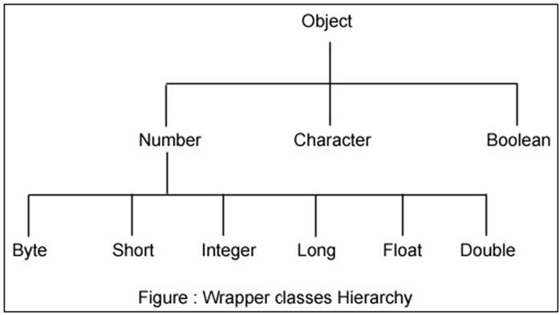
Wrapper Classes
Let’s work on the common Class
Integer

Slide 57
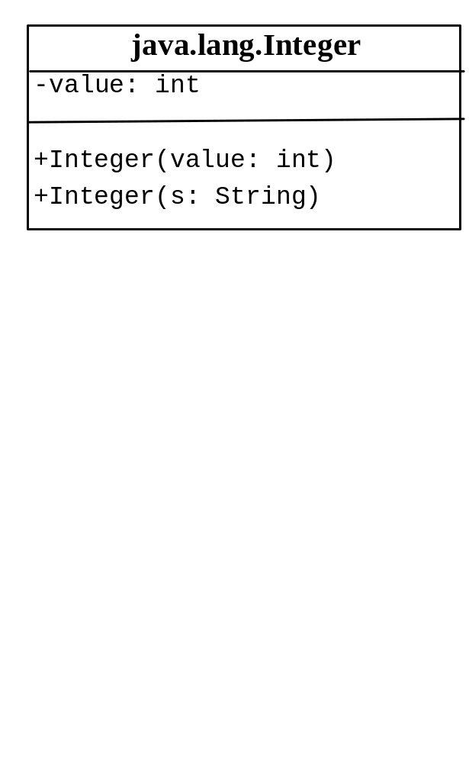
The Integer Class
Constructors
  Integer x = 5;
  Integer x = new Integer (5);
  Integer x = new Integer (“5”);
Does the Wrapper classes have no-arg constructors?
The creation is similar to the String Class, so what is common between them?
NO
The instances of all wrapper classes are immutable, i.e., their internal values cannot be changed once the objects are created.

Slide 58
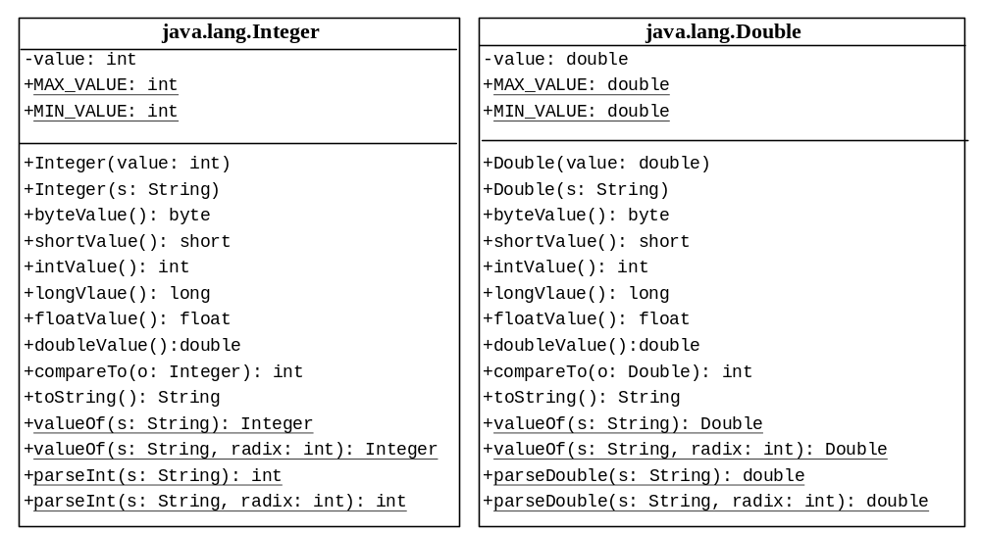
The Integer and Double Classes

Slide 59
Constructors and Constants
You can construct a wrapper object either from a primitive data type value or from a string representing the numeric value—for example, new Double(5.0), new Double("5.0"), new Integer(5), and new Integer("5").
The wrapper classes do not have no-arg constructors. The instances of all wrapper classes are immutable; this means that, once the objects are created, their internal values cannot be changed.
Each numeric wrapper class has the constants MAX_VALUE and MIN_VALUE. MAX_VALUE represents the maximum value of the corresponding primitive data type.

Slide 60
Conversion methods
Each numeric wrapper class contains the methods doubleValue(), floatValue(), intValue(), longValue(), and shortValue() for returning a double, float, int, long, or short value for the wrapper object.
For example,
new Double(12.4).intValue() returns 12;
new Integer(12).doubleValue() returns 12.0;

Slide 61
compareTo method
Recall that the String class contains the compareTo method for comparing two strings.
The numeric wrapper classes contain the compareTo method for comparing two numbers and returns 1, 0, or -1, if this number is greater than, equal to, or less than the other number.
new Double(12.4).compareTo(new Double(12.3)) returns 1;
new Double(12.3).compareTo(new Double(12.3)) returns 0;
new Double(12.3).compareTo(new Double(12.51)) returns -1;

Slide 62
static valueOf methods
The numeric wrapper classes have a useful static method, valueOf (String s).
This method creates a new object initialized to the value represented by the specified string.
For example,
Double doubleObject = Double.valueOf("12.4");
Integer integerObject = Integer.valueOf("12");

Slide 63
static parsing methods
The parseInt method in the Integer class to parse a numeric string into an int value (primitive type) and the parseDouble method in the Double class to parse a numeric string into a double value.
Each numeric wrapper class has two overloaded parsing methods to parse a numeric string into an appropriate numeric value based on 10 (decimal) or any specified radix (e.g., 2 for binary, 8 for octal, and 16 for hexadecimal).
Integer.parseInt("11") returns 11
Integer.parseInt("11", 2) returns 3;

Slide 64
static parsing methods
Integer.parseInt("11", 2) returns 3;
Integer.parseInt("12", 8) returns 10;
Integer.parseInt("13", 10) returns 13;
Integer.parseInt("1A", 16) returns 26;
Integer.parseInt("12", 2) would raise a runtime exception because 12 is not a binary number.
Note that you can convert a decimal number into a hex number using the format method. For example,
String.format("%x", 26) returns 1A;

Slide 65
Automatic Conversion between Primitive Types and Wrapper Class Types
A primitive type value can be automatically converted to an object using a wrapper class, and vice versa, depending on the context.
Converting a primitive value to a wrapper object is called boxing.
The reverse conversion is called unboxing.
The compiler will automatically box a primitive value that appears in a context requiring an object and will unbox an object that appears in a context requiring a primitive value.

Slide 66
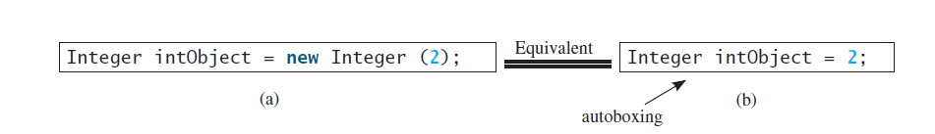
Automatic Conversion between Primitive Types and Wrapper Class Types
Integer[] intArray = {1, 2, 3};
the primitive values 1,2, and 3 are automatically boxed into objects new Integer(1), new Integer(2), and new Integer(3).

Slide 67
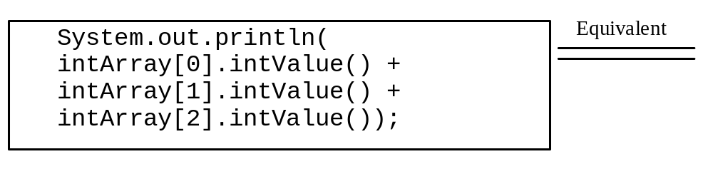
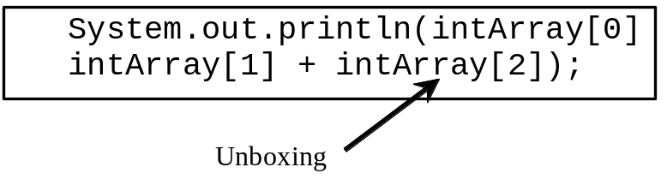
Automatic Conversion between Primitive Types and Wrapper Class Types
+
System.out.println(intArray[0] + intArray[1] + intArray[2]);
the objects intArray[0], intArray[1], and intArray[2] are automatically unboxed into int values that are added together.

Slide 68
The BigInteger and BigDecimal Classes
If you need to compute with very large integers or high-precision floating-point values, you can use the BigInteger and BigDecimal classes.
An instance of BigInteger can represent an integer of any size.
Both are immutable. Both extend the Number class and implement the Comparable interface.

Slide 69
BigInteger and BigDecimal
BigInteger a = new BigInteger("9223372036854775807");
BigInteger b = new BigInteger("2");
BigInteger c = a.multiply(b); // 9223372036854775807 * 2
System.out.println(c);
Output = 18446744073709551614
LargeFactorial
Run
BigDecimal a = new BigDecimal(1.0);
BigDecimal b = new BigDecimal(3);
BigDecimal c = a.divide(b, 20, BigDecimal.ROUND_UP);
System.out.println(c);
Rounding mode
Scale is the max no. of digits after the decimal point
Output = 0.33333333333333333334

